Slide 1


Overview on SAP HANA and HANA Cloud Platform
by Gopala KR
Tech Tuesday,13thDec-2016
Dell EMC |Accenture MDC2B

Slide 2
Agenda
PART 1 : SAP HANA Technology
What is in-memory computing?
Harware vendors
PART 2 : SAP HANA Architecture
Architecture overview
Data provisioning in SAP HANA
PART 3 : SAP HANA Studio
SAP HANA Studio
HANA SQL and Functions
HANA modeling and reporting
PART 4 : SAP HANA Cloud Platform
Architecture overview
Capabilities and services
SAP HANA for developers
PART 5 : SAP HANA use cases
By Business -
By Product -

Slide 3












PART 1: SAP HANA
Technology
HANA
Use cases
Technology
HANA
Development
Architecture
Deployment Scenarios

Slide 4

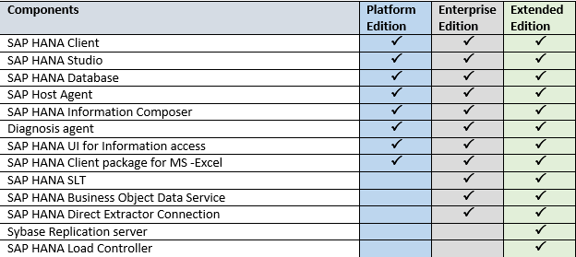
What is SAP HANA High Performance Analytic Appliance
SAP HANA is an in-memory data platform that is deployable as an On-premise appliance, or in the cloud.
At the core of this real-time data platform is the SAP HANA database, which is fundamentally different from any other database engine in the market today
Best suited for real-time analytics and applications.
SAP HANA has two part –
1. SAP HANA Database
2. SAP HANA Platform

Slide 5
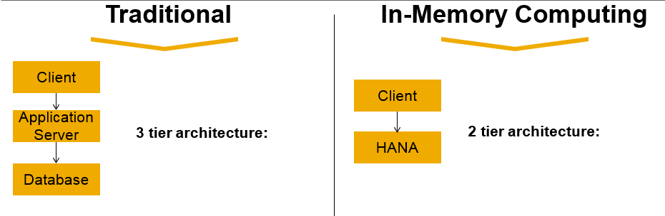






What is In-Memory computing Technology innovation
Dramatically improved hardware economics and technology innovations in software have made it possible for SAP to deliver on its vision of the Real-Time Enterprise with in-memory business applications
HW Technology Innovations
SAP SW Technology Innovations
Row and Column Store
Multi-Core Architecture
(8 CPU x 10 Cores per blade)
Massive parallel scaling with many blades
Compression
Partitioning
64bit address space – 1TB in current servers
Dramatic decline in
price/performance
No Aggregate Tables
Insert Only on Delta

Slide 6
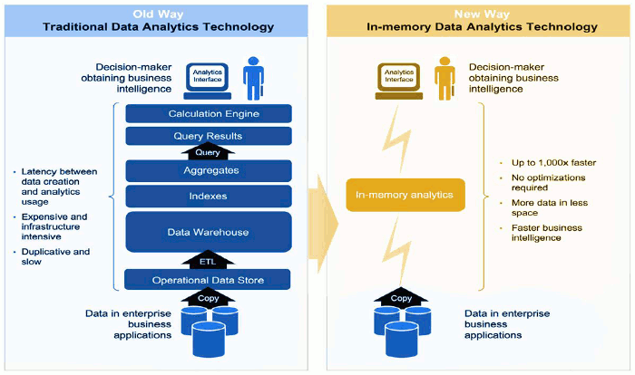
What is In-Memory computing Technology innovation

Slide 7
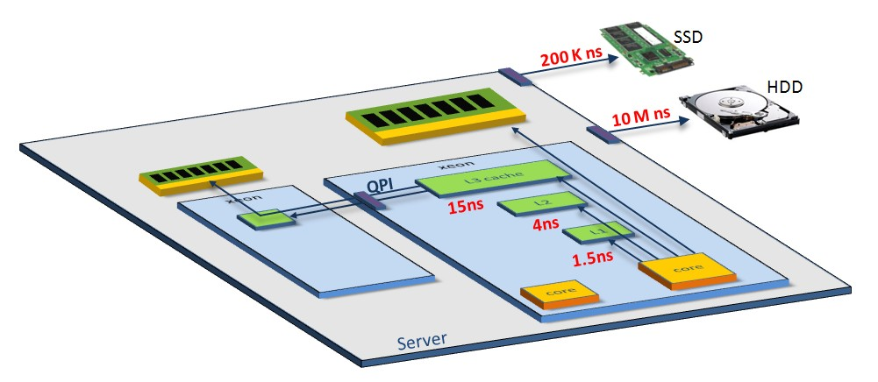




In-Memory computing
Challenges of In-memory Computing
Challenge 1: Parallelism! Take advantage of tens, hundreds of cores
Challenge 2: Data locality!
Yes, DRAM is 100,000 times faster than disk…
But DRAM access is still 4-60 times slower than on-chip caches

Slide 8
In-Memory computing
Delegation of data intense operations to the in-memory computing
Today‘s applications execute many data intense operations in the application layer
Application Layer
Data Layer
High performance apps delegate data intense operations to the
in-memory computing
In-Memory Computing Imperative:
Avoid movement of detailed data Calculate first, then move results

Slide 9
In-Memory computing
Challenges: Use cache-conscious data-structures and algorithms
Programming against a new scarce resource…
CPU
Core
CPU Cache
Performance bottleneck today: CPU waiting for data to be loaded from memory into cache
Performance bottleneck in the past: Disk I/O
Main Memory
Disk
… requires cache-conscious data-structures and algorithms.

Slide 10


In-Memory computing
Delegation of data intense operations to the in-memory computing
Traditional In-Memory Computing
Application
Mass data
Database
Mass data
Typical assumption: DB is too slow,
app server must optimize (caching)
Assumption: do everything with the
data where the data is

Slide 11
In-Memory computing Security implications
Traditional
In-Memory Computing
Client
3 tier architecture:
2 tier architecture:
Users log on directly to HANA
Users exist in HANA
Authorization is handled by HANA
Client
Application Server
Users exist in application server only
Authorization is handled by application server
DB is accessed with technical user
HANA
Database
Security is handled by application server
Security is handled by database

Slide 12
In-Memory computing Summary - Why SAP HANA?
Few reasons why to choose SAP HANA –
Real Time
Speed
Any Data/Source
Cloud
Simplicity
Cost
Choice Option

Slide 13
PART 2 & 3: SAP HANA
Architecture and HANA Studio
HANA
Use cases
Technology
HANA
Development
Architecture
Deployment Scenarios

Slide 14
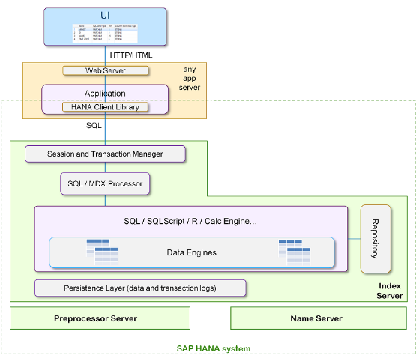
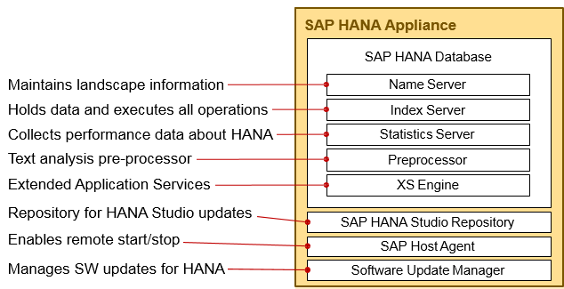
SAP HANA Database Architecture High level Architecture and components

Slide 15
SAP HANA Architecture
High level Architecture and Deployment view
Single host configuration
Multi-node cluster configuration
SAP HANA Appliance
SAP HANA Database Node 2
Node n
Maintains landscape information
Holds data and executes all operations
Collects performance data about HANA
Text analysis pre-processor Extended Application Services
Name Server
…
Index Server Index Server
Index Server
Statistics Server
Preprocessor
Preprocessor
Preprocessor
XS Engine
Repository for HANA Studio updates Enables remote start/stop
Manages SW updates for HANA
SAP HANA Studio Repository
SAP Host Agent
SAP Host Agent
SAP Host Agent
Software Update Manager
Shared persistency for fail-over and recovery

Slide 16
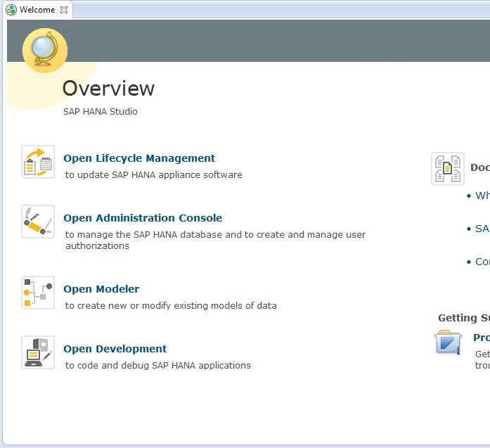
SAP HANA Studio Administration and Development Tool for SAP HANA
The SAP HANA studio runs on the Eclipse platform and is both the central development environment and the main administration tool for SAP HANA.
Administrators can use the SAP HANA studio, for example, to start and stop services, to monitor the system, to configure system settings, and to manage users and authorizations. The SAP HANA studio accesses the servers of the SAP HANA database by SQL.
The SAP HANA studio presents its various tools in the form of perspectives. Database administration and monitoring features are contained primarily within the Administration Console perspective.

Slide 17
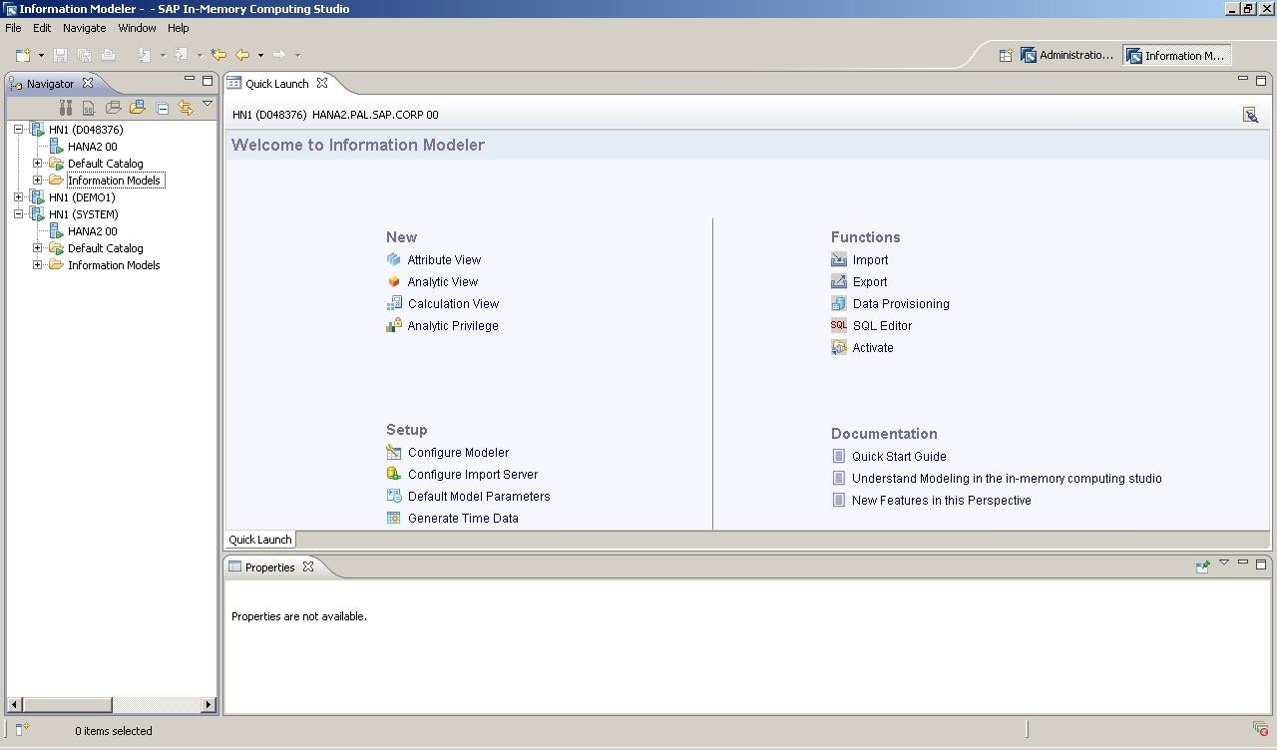

SAP In-Memory(HANA) Computing Studio Features
Information Modeler Features
Modeling
No materialized aggregates
Database views
Choice to publish and consume at 4 levels of modeling
Attribute View, Analytic View, Analytic View enhanced with Attribute View, Calculation View
Data Preview
Physical tables
Information Models
Import/Export
Models
Data Source schemas (metadata) – mass and selective load
Landscapes
Data Provisioning for SAP Business Applications (both initial load and replication)
Analytic Privileges / Security
Quick Launch
View
Navigator
View

Slide 18
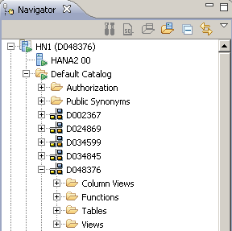
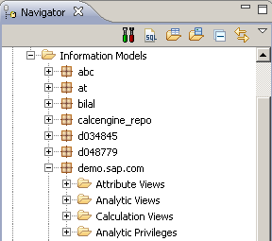
SAP HANA Studio
Navigator View - Default Catalog & Information Models
HANA Instance (<USER>)
HANA Server Name and Instance Number
User Database schema
Schema Content: Column Views, Functions, Tables, Views
Information Models organized in Packages
Attribute Views, Analytic Views, Calculation Views, Analytic Privileges organised in folders

Slide 19
SAP HANA Studio Data Provisioning in SAP HANA
DATA Provisioning is a process of creating, preparing, and enabling a network to provide data to its user. Data needs to be loaded to SAP HANA before data reaches to the user via a front-end tool.
SAP HANA supports two type of Provisioning tool –
SAP HANA built-in Provisioning Tools
Flat File
Smart Data Streaming
Smart Data Access (SDA)
2. External Tools supported by SAP HANA
SAP Landscape Transformation
SAP Business Objects Data Services
SAP Direct Extractor Connection
Sybase Replication Server

Slide 20

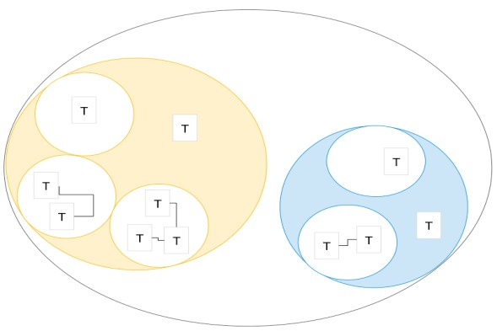
Using data in SAP HANA
Query
SELECT … FROM … WHERE …
Statement Processor
Execution plan
Calculation Engine
O
p
O
p
O
p
O
p
Data Stores
Views
O
p
O
p
O
p
O
p
Persistency Layer
Save
Logs
Point

Slide 21
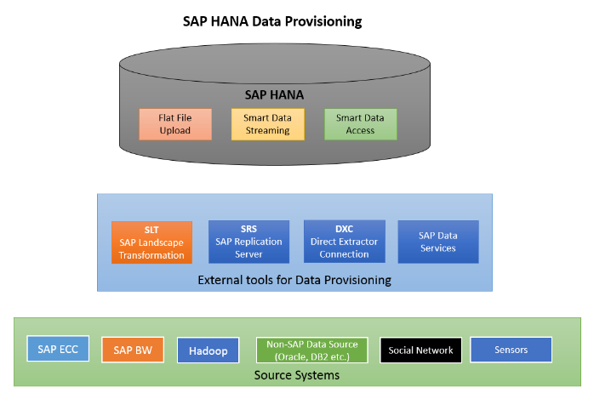
SAP HANA Studio Data Provisioning in SAP HANA

Slide 22
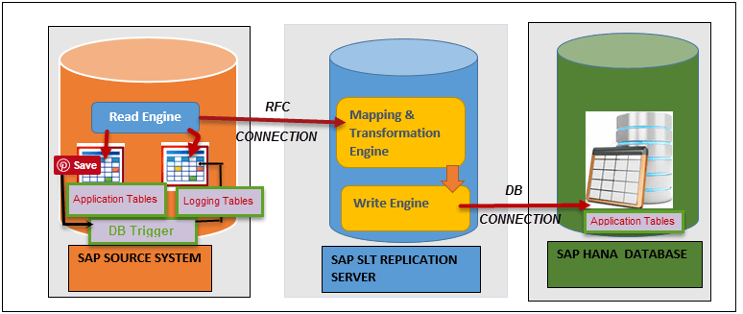
SAP HANA Studio Data Provisioning in SAP HANA – SLT explained

Slide 23
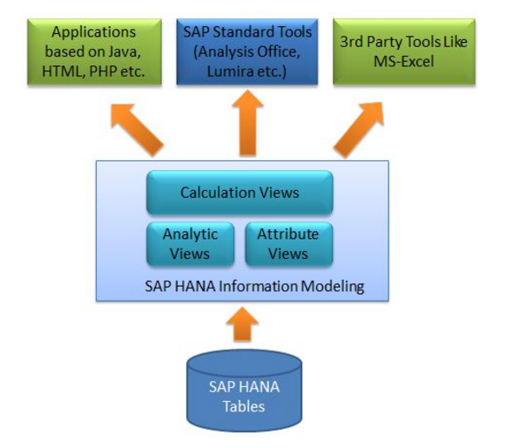
SAP HANA Studio Using stored data – Data Modeling
Modelling is an activity in which user refine or slice data in the database table by creating information view based on the business scenario.
This information views can be used for reporting and decision-making purpose.

Slide 24
SAP HANA Studio Using stored data – Data Modeling
Attributes : Descriptive and Non-Measureable Data. E.g. Vendor ID, Vendor Name, City, etc.
Measures : Data can be quantifiable and calculated. E.g. Revenue, Quantity Sold and Counters.
Attribute View
Calculation View
T
T
Views enable real-time computing by transforming data on the fly.
S
O
T
Example:
E: Employee Table
O: Organization table
S: Sales Transactions
E
T
T
T
E
O
Table
Analytic View

Slide 25
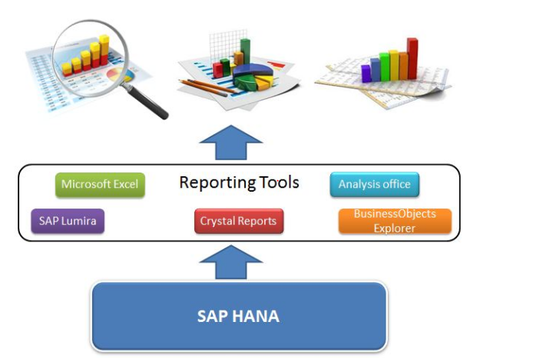
SAP HANA Studio Using stored data – Reporting
Recommended frontend tools
SAP BusinessObjects Analysis
SAP BusinessObjects Explorer
SAP Lumira
SAP Business Objects Crystal Reports
SAP BusinessObjects Dashboards

Slide 26
PART 4: SAP HANA Cloud Platform
HANA
Use cases
Technology
HANA
Development
Architecture
Deployment Scenarios

Slide 27
SAP HANA Cloud Platform The Platform-as-a-Service to Extend, Integrate, and Build Business Apps
SAP HANA Cloud Platform is an in-memory cloud platform based on open standards. It provides access to a feature-rich, easy-to-use development environment in the cloud.
The platform includes a comprehensive set of services for integration, enterprise mobility, collaboration, and analytics
SAP HANA Cloud Platform enables customers and partners to rapidly build, deploy, and manage cloud-based enterprise applications that complement and extend SAP or non-SAP solutions, either on-premise or on-demand.
HANA
Use cases

Slide 28
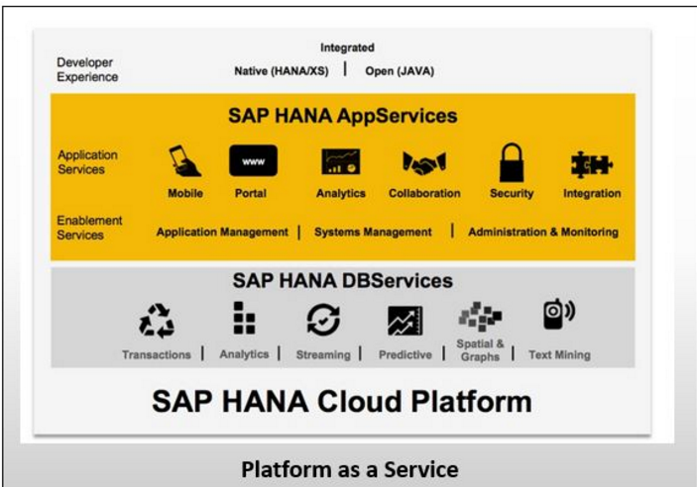
SAP HANA Cloud Platform Interactive Architecture and Capabilities

Slide 29
SAP HANA Cloud Platform Scenarios
BUILD New Cloud Apps
EXTEND On-Premise Apps
EXTEND Cloud Apps
ON-PREMISE SOLUTION
CLOUD SOLUTION
Data
Data
RUN Application Management and Runtime

Slide 30
SAP HANA Cloud Platform Application Development
Programming models to build highly scalable applications:
Java - SAP HANA Cloud Platform is Java EE 6 Web Profile certified. You can develop Java applications just like for any application server. You can also easily run your existing Java applications on the platform.
SAP HANA - you can use the SAP HANA development tools to create comprehensive analytical models and build applications with SAP HANA programmatic interfaces and integrated development environment.
HTML5 - you can easily develop and run lightweight HTML5 applications in a cloud environment.
SAPUI5 - use the UI Development Toolkit for HTML5 (SAPUI5) for developing rich user interfaces for modern Web business applications.

Slide 31
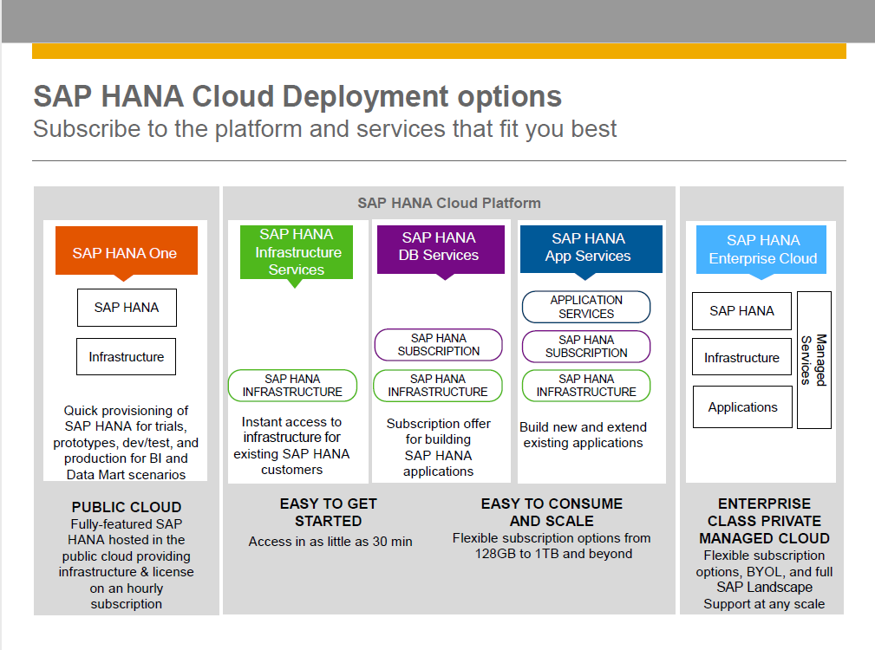

Slide 32
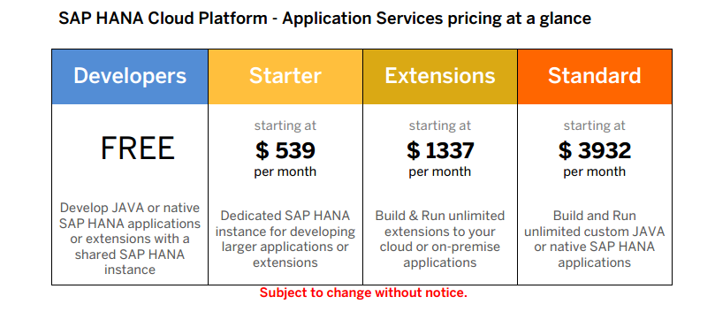
Available Editions: SAP HANA App Services

Slide 33
Further Information
SAP Public Web
http://www.sap.com/hana http://experiencesaphana.com/ http://scn.sap.com/community/hana-in-memory http://opensap.com
36

Slide 34
Thank you

